Slide 1
Analysing Neighborhood in Toronto
Upasana Dhar
IBM- Capstone Project Presentation

Slide 2
BACKGORUND
Toronto is the provincial capital of Ontario and the most populous city in Canada
Population of 2,731,571 in 2016. The majority of which is within the Greater Toronto Area (GTA), held a population of 5,928,040, making it Canada's most populous CMA.
The city is the anchor of the Golden Horseshoe, an urban agglomeration of 9,245,438 people (as of 2016) surrounding the western end of Lake Ontario.
It’s an international centre of business, finance, arts, and culture, and is recognized as one of the most multicultural and cosmopolitan cities in the world.

Slide 3
AIM
Toronto is a city with a high population and population density.
Owners of shops and social sharing places in the city where the population is dense. When we think of it by the investor, we expect from them to prefer the areas where a particular business has less competition and the type of business they want to install is less intense.
For city residents, they may want to choose the district according to the social place’s density.
Hence, our main aim in this project has been to analyze the venues on each neighborhood which can help both residents while choosing their housing based on housing or investors while choosing where and which company/firm to invest on.

Slide 4
DATA ACQUISITION AND CLEANING
Master data which has the main components Postal codes, Neighborhood, Borough, Latitude and Longitude informations of the city scrapped from https://en.wikipedia.org/wiki/List_of_postal_codes_of_Canada:_M,
From the link : http://cocl.us/Geospatial_data, I downloaded the dataset to obtain the geographical coordinates of each postal code
There are total 103 neighborhood areas with unique postal codes in entire Canada dataset.
The dataset was cleaned where duplicate postal codes were grouped together and not assigned values were dropped.
Cleaned dataset contained only postal codes of Toronto city were selected. It contains 87 neighborhood areas with unique postal codes

Slide 5
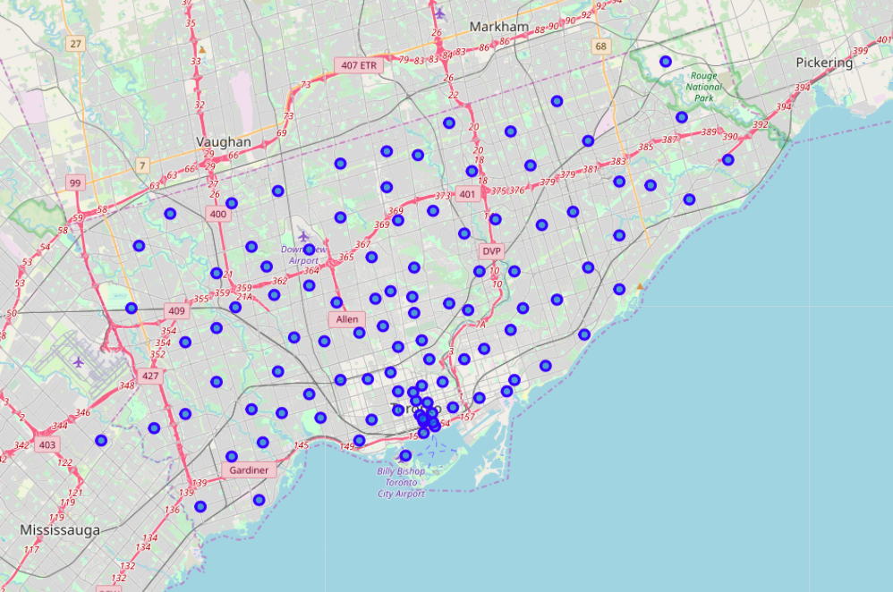
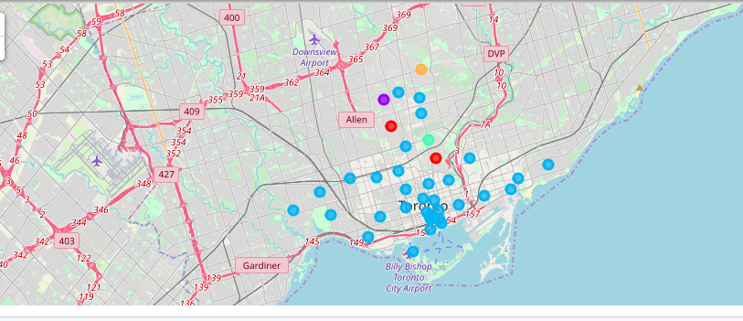
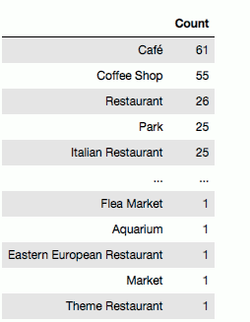
Neighborhood around Toronto
Clustered Neighborhood based on venues around Toronto
Most Common and least common venues around Toronto neighborhood

Slide 6
Conclusion
The most common venue in Toronto city is Café/Coffee shop.
Most of the coffee shops/café are located near the bay area away from the Downsview airport, which seems more commercialized center.
Neighborhood proximal to the Downview airport and occurring as small individual clusters have Park, Trails, Garden etc, venues in common. This seems to be neighborhood areas with mainly residential spaces with quiet and spacious surroundings amidst trails and parks.
An investor may target localities/neighborhoods such as The Beaches, Riverdale, Davisville, Studio District, North Toronto West etc near the bay areas which are heavily commercialized and frequent visiting spots.
However, since café/ coffee shops and also restaurants are already flooding these neighborhoods, the competition on opening a firm with the same product will be large. So recommended some other commercial firms such as Metro Plaza, movie theatres or some public spots in these areas would be more profitable. While opening a café/coffee shop near the Downview airport in localities such as Lawrence Park, Summer hill etc would have less competition but again these areas seem to be less socially populated, there will be less customer influx.
In conclusion, this project gives interesting insights an can be used as a navigating tool to recommend places to start new projects/firms in Toronto city but would have had better results if there were more data in terms of crime data within the area, traffic access and allowance of more venues exploration with the Foursquare (limited venues for free calls).

